Slide 1
The Voxy Learning Platform & IIS-RU
Presented by Ajarn Ian James Sanderson
Institute of International Studies
Ramkhamhaeng University
TQF/KM Meeting - 6th May 2021

Slide 2
Overview
What is Voxy?
The IIS-RU and Voxy partnership
How students join the program
The Voxy Proficiency Assessment (VPA)
What Voxy does
Benefits for students
Benefits for lecturers
Suitability with our programs
Opinion and recommendations
Q&A

Slide 3
What is Voxy?
Voxy is an online interactive learning platform
English training for higher education (among others)
Students access engaging, high-quality authentic language content
Helps prepare students to succeed both academically and professionally

Slide 4
IIS-RU & VOXY
As part of our TQF and KM objectives, IIS-RU has partnered with Voxy to enhance the students’ learning experience
This is in line with Track 1 of our Knowledge Management objectives
Production of graduates – Students’ preparation

Slide 5
How Students Join
The courses in which the Voxy platform can provide enhanced learning and practice for students are established first
IIS-RU then registers students with Voxy
Students receive a welcome email to activate their account just before the IIS-RU course starts
Voxy can be accessed 24/7 through a PC or a mobile device
The latter is not recommended for any important assessments or tests
Instructor adds Voxy information to Google Classroom

Slide 6
How Students Join

Slide 7
The Voxy Proficiency Assessment (VPA)
The first thing each student must do is complete the VPA
There are a number of benefits to completing the VPA
Students get immediate feedback on their grammatical accuracy, listening comprehension, and reading comprehension skills
Students can then focus on their individual weaknesses
Voxy’s AI will assign work based on each student’s needs, interests and requirements
Students know instantly how their VPA score compares to other internationally recognized English standards assessment tests, such as IELTS, TOEIC, TOEFL, CEFR, GSE, and PTE

Slide 8
VPA Prompt Screen

Slide 9
VPA Assessment Levels

Slide 10
Voxy in Google Classroom

Slide 11
Voxy in Google Classroom

Slide 12
Voxy in Google Classroom

Slide 13
What Voxy Does
Voxy offers a catalogue from which students can choose subjects, or lectures can assign work instead
Voxy’s AI then keeps track of each student’s progress
Increases or decreases the level of difficulty according to the individual
Provides a range of content from beginner to advanced level English
Voxy continuously records and provides feedback to the student on fundamental English skills
Grammar
Vocabulary
Writing
Listening
Reading
Speaking
Time spent studying, number of units covered, and the content that each student accessed is tracked and reported

Slide 14
Voxy Catalogue

Slide 15
A Typical Activity

Slide 16
Performance Feedback

Slide 17
Optimal Usage

Slide 18
Benefits for Students
Know their own strengths and weaknesses and either capitalize or act on them
Know in advance what kind of jobs they might be able to apply for
Pre-assess their suitability for certain careers
Voxy’s material spans a diverse range of industries
Learn at their own pace and follow their own interests
Be better able to graduate with improved GPA

Slide 19
Benefits for Lectures
Assign material directly related to the course being taught
Get instant feedback on students’ weaknesses
See which students are engaged and to what degree
Fully adaptable reporting options
Use as a contingency when things don’t go according to plan
Use to justify a research population

Slide 20
Voxy Command Centre

Slide 21
Suitability with Subjects
Great for office-based English courses
Secretarial English
English in the Field of International Business
Also good for General English and English Major courses
IEN1001 / IEN1002 (Sentences and Vocabulary)
IEN2001 (Reading Comprehension)
IEN2102 (Controlled Conversation)
IEN3301 (Listening Comprehension)
Plus many more…
However, Voxy is not really suitable for linguistics courses
Although there is some AI to assess pronunciation accuracy

Slide 22
Problem – Solution Tips
Student(s) cannot access the system
You will need Voxy’s help with this!
Provide Voxy contact details in your online classroom a day before the course starts
Voxy acts almost instantly in every case. The service is good
Voxy can be contacted by Line, email, or by telephone

Slide 23
Problem – Solution Tips
Student is unsure how to use Voxy effectively
Provide copies of both the Voxy Study Guide and the Voxy Study Plan (two files) in your online classroom
Learn how Voxy works by yourself initially. Then you can share your knowledge
Give a live online demonstration in your classroom before you assign the first activity
Voxy can also help here. They can be contacted by Line, email, or telephone during all regular course hours

Slide 24
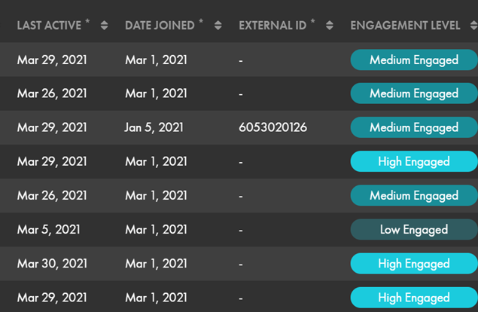
Problem – Solution Tips
Student is not engaged
Provide feedback to student on an individual basis
Send student evidence of your findings
Remind the student of the importance of engagement and it’s inclusion in your grading criteria

Slide 25
Problem – Solution Tips
Student does not understand some part of the language or how it is being applied in the activity
Provide feedback to student(s) either individually or as a group on a case-by-case basis
Always encourage students to ask questions after the session
Remind the students of the importance of follow-up Q and A to improve and share knowledge
Don’t simply assign work. Be online for the usual course hours especially while your class is engaged in Voxy.

Slide 26
Opinion & Recommendations
Enhances student learning
Contributes to production of graduates
Excellent in and out of class hours as a supplement
Flexible and adaptable
VPA potential as an entrance exam
Potential for research
Not suitable for all courses
Obtain more student feedback
Faculty must be committed to KM objectives

Slide 27
Q & A

Slide 28
Acknowledgements
All images and some text are sourced from the Voxy Study Guide and Voxy Study Plan
Further information is also available from
www.voxy.com or by contacting the Voxy IIS-RU Team

